Slide 1

UNIVERSITY INSTITUTE OF ENGINEERING
COMPUTER SCIENCE ENGINEERING
ARTIFICIAL INTELLIGENCE
(23 CSH - 621)
INTRODUCTION
DISCOVER . LEARN . EMPOWER

Slide 2
History of AI
CS-based AI started with “Dartmouth Conference” in 1956
Attendees
John McCarthy
LISP, application of logic to reasoning
Marvin Minsky
Popularized neural networks
Slots and frames
The Society of the Mind
Claude Shannon
Computer checkers
Information theory
Open-loop 5-ball juggling
Allen Newell and Herb Simon
General Problem Solver

Slide 3
AI Questions
Can we make something that is as intelligent as a human?
Can we make something that is as intelligent as a bee?
Can we make something that is evolutionary, self improving, autonomous, and flexible?
Can we save this plant $20M/year by pattern recognition?
Can we save this bank $50M/year by automatic fraud detection?
Can we start a new industry of handwriting recognition agents?

Slide 4
Which of these exhibits intelligence?
You beat somebody at chess.
You prove a mathematical theorem using a set of known axioms.
You need to buy some supplies, meet three different colleagues, return books to the library, and exercise. You plan your day in such a way that everything is achieved in an efficient manner.
You are a lawyer who is asked to defend someone. You recall three similar cases in which the defendant was guilty, and you turn down the potential client.
A stranger passing you on the street notices your watch and asks, “Can you tell me the time?” You say, “It is 3:00.”
You are told to find a large Phillips screwdriver in a cluttered workroom. You enter the room (you have never been there before), search without falling over objects, and eventually find the screwdriver.

Slide 5
Which of these exhibits intelligence?
You are a six-month-old infant. You can produce sounds with your vocal organs, and you can hear speech sounds around you, but you do not know how to make the sounds you are hearing. In the next year, you figure out what the sounds of your parents' language are and how to make them.
You are a one-year-old child learning Arabic. You hear strings of sounds and figure out that they are associated with particular meanings in the world. Within two years, you learn how to segment the strings into meaningful parts and produce your own words and sentences.
Someone taps a rhythm, and you are able to beat along with it and to continue it even after it stops.
You are some sort of primitive invertebrate. You know nothing about how to move about in your world, only that you need to find food and keep from bumping into walls. After lots of reinforcement and punishment, you get around just fine.

Slide 6
Which of these can currently be done?
Play a decent game of table tennis
Drive autonomously along a curving mountain road
Drive autonomously in the center of Cairo
Play a decent game of bridge
Discover and prove a new mathematical theorem
Write an intentionally funny story
Give competent legal advice in a specialized area of law
Translate spoken English into spoken Swedish in real time
Plan schedule of operations for a NASA spacecraft
Defeat the world champion in chess

Slide 7
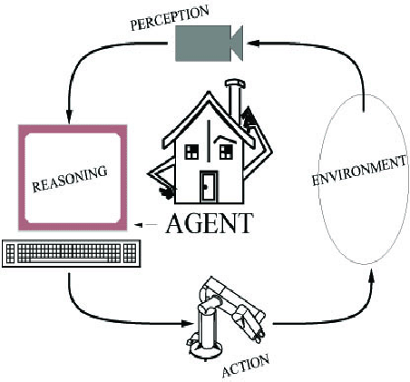
Components of an AI System
An agent perceives its environment
through sensors and acts on the
environment through actuators.
Human: sensors are eyes, ears,
actuators (effectors) are hands,
legs, mouth.
Robot: sensors are cameras, sonar,
lasers, ladar, bump, effectors are
grippers, manipulators, motors
The agent’s behavior is described by its
function that maps percept to action.
Notes:
LADAR is Laser Detection and Ranging
Light radar by uses light

Slide 8
Rationality
A rational agent does the right thing (what is this?)
A fixed performance measure evaluates the sequence of observed action effects on the environment

Slide 9
PEAS
Use PEAS to describe task
Performance measure
Environment
Actuators
Sensors

Slide 10
PEAS
Use PEAS to describe task environment
Performance measure
Environment
Actuators
Sensors
Example: Taxi driver
Performance measure: safe, fast, comfortable (maximize profits)
Environment: roads, other traffic, pedestrians, customers
Actuators: steering, accelerator, brake, signal, horn
Sensors: cameras, sonar, speedometer, GPS, odometer, accelerometer, engine sensors

Slide 11
Environment Properties
Fully observable vs. partially observable
Deterministic vs. stochastic / strategic
Episodic vs. sequential
Static vs. dynamic
Discrete vs. continuous
Single agent vs. multiagent
Notes:
Fully observable vs. partially observable
Environment sensors provide access to complete state of the
relevant environment at each point in time
Deterministic vs. stochastic / strategic
If next state completely determined by current and action,
then deterministic, otherwise stochastic
If deterministic except for actions of other agents,
then strategic
Episodic vs. sequential
Episodic, action choice depends only on current state
Sequential, current action may affect future actions
Static vs. dynamic
Dynamic, environment can change while agent is deliberating
Discrete vs. continuous
Applied to state, time, percepts, or actions
The way the information is represented
Single agent vs. multiagent
How distinguish agent from environment?
if other's behavior maximizes its performance based on
agent, then it is multiagent

Slide 12
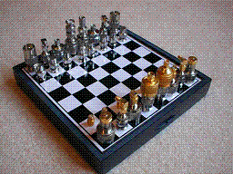
Environment Examples
Environment | Observable | Deterministic | Episodic | Static | Discrete | Agents
Chess with a clock
Chess without a clock
Fully observable vs. partially observable
Deterministic vs. stochastic / strategic
Episodic vs. sequential
Static vs. dynamic
Discrete vs. continuous
Single agent vs. multiagent

Slide 13
Environment Examples
Environment | Observable | Deterministic | Episodic | Static | Discrete | Agents
Chess with a clock | Fully | Strategic | Sequential | Semi | Discrete | Multi
Chess without a clock | Fully | Strategic | Sequential | Static | Discrete | Multi
Fully observable vs. partially observable
Deterministic vs. stochastic / strategic
Episodic vs. sequential
Static vs. dynamic
Discrete vs. continuous
Single agent vs. multiagent

Slide 14
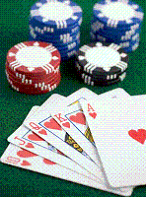
Environment Examples
Environment | Observable | Deterministic | Episodic | Static | Discrete | Agents
Chess with a clock | Fully | Strategic | Sequential | Semi | Discrete | Multi
Chess without a clock | Fully | Strategic | Sequential | Static | Discrete | Multi
Poker
Fully observable vs. partially observable
Deterministic vs. stochastic / strategic
Episodic vs. sequential
Static vs. dynamic
Discrete vs. continuous
Single agent vs. multiagent

Slide 15
Environment Examples
Environment | Observable | Deterministic | Episodic | Static | Discrete | Agents
Chess with a clock | Fully | Strategic | Sequential | Semi | Discrete | Multi
Chess without a clock | Fully | Strategic | Sequential | Static | Discrete | Multi
Poker | Partial | Strategic | Sequential | Static | Discrete | Multi
Fully observable vs. partially observable
Deterministic vs. stochastic / strategic
Episodic vs. sequential
Static vs. dynamic
Discrete vs. continuous
Single agent vs. multiagent

Slide 16
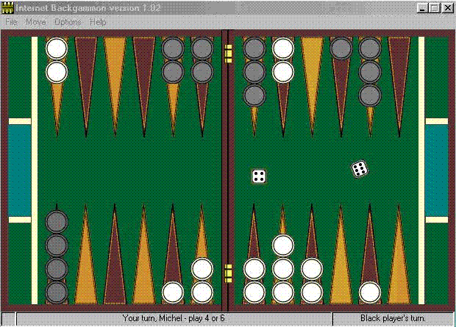
Environment Examples
Environment | Observable | Deterministic | Episodic | Static | Discrete | Agents
Chess with a clock | Fully | Strategic | Sequential | Semi | Discrete | Multi
Chess without a clock | Fully | Strategic | Sequential | Static | Discrete | Multi
Poker | Partial | Strategic | Sequential | Static | Discrete | Multi
Backgammon
Fully observable vs. partially observable
Deterministic vs. stochastic / strategic
Episodic vs. sequential
Static vs. dynamic
Discrete vs. continuous
Single agent vs. multiagent

Slide 17
Environment Examples
Environment | Observable | Deterministic | Episodic | Static | Discrete | Agents
Chess with a clock | Fully | Strategic | Sequential | Semi | Discrete | Multi
Chess without a clock | Fully | Strategic | Sequential | Static | Discrete | Multi
Poker | Partial | Strategic | Sequential | Static | Discrete | Multi
Backgammon | Fully | Stochastic | Sequential | Static | Discrete | Multi
Fully observable vs. partially observable
Deterministic vs. stochastic / strategic
Episodic vs. sequential
Static vs. dynamic
Discrete vs. continuous
Single agent vs. multiagent

Slide 18
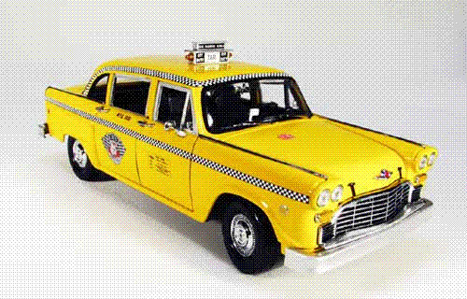
Environment Examples
Environment | Observable | Deterministic | Episodic | Static | Discrete | Agents
Chess with a clock | Fully | Strategic | Sequential | Semi | Discrete | Multi
Chess without a clock | Fully | Strategic | Sequential | Static | Discrete | Multi
Poker | Partial | Strategic | Sequential | Static | Discrete | Multi
Backgammon | Fully | Stochastic | Sequential | Static | Discrete | Multi
Taxi driving | Partial | Stochastic | Sequential | Dynamic | Continuous | Multi
Fully observable vs. partially observable
Deterministic vs. stochastic / strategic
Episodic vs. sequential
Static vs. dynamic
Discrete vs. continuous
Single agent vs. multiagent

Slide 19

Environment Examples
Environment | Observable | Deterministic | Episodic | Static | Discrete | Agents
Chess with a clock | Fully | Strategic | Sequential | Semi | Discrete | Multi
Chess without a clock | Fully | Strategic | Sequential | Static | Discrete | Multi
Poker | Partial | Strategic | Sequential | Static | Discrete | Multi
Backgammon | Fully | Stochastic | Sequential | Static | Discrete | Multi
Taxi driving | Partial | Stochastic | Sequential | Dynamic | Continuous | Multi
Medical diagnosis
Fully observable vs. partially observable
Deterministic vs. stochastic / strategic
Episodic vs. sequential
Static vs. dynamic
Discrete vs. continuous
Single agent vs. multiagent

Slide 20
Environment Examples
Environment | Observable | Deterministic | Episodic | Static | Discrete | Agents
Chess with a clock | Fully | Strategic | Sequential | Semi | Discrete | Multi
Chess without a clock | Fully | Strategic | Sequential | Static | Discrete | Multi
Poker | Partial | Strategic | Sequential | Static | Discrete | Multi
Backgammon | Fully | Stochastic | Sequential | Static | Discrete | Multi
Taxi driving | Partial | Stochastic | Sequential | Dynamic | Continuous | Multi
Medical diagnosis | Partial | Stochastic | Episodic | Static | Continuous | Single
Fully observable vs. partially observable
Deterministic vs. stochastic / strategic
Episodic vs. sequential
Static vs. dynamic
Discrete vs. continuous
Single agent vs. multiagent

Slide 21
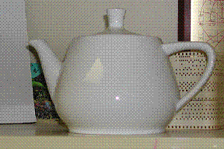
Environment Examples
Environment | Observable | Deterministic | Episodic | Static | Discrete | Agents
Chess with a clock | Fully | Strategic | Sequential | Semi | Discrete | Multi
Chess without a clock | Fully | Strategic | Sequential | Static | Discrete | Multi
Poker | Partial | Strategic | Sequential | Static | Discrete | Multi
Backgammon | Fully | Stochastic | Sequential | Static | Discrete | Multi
Taxi driving | Partial | Stochastic | Sequential | Dynamic | Continuous | Multi
Medical diagnosis | Partial | Stochastic | Episodic | Static | Continuous | Single
Image analysis
Fully observable vs. partially observable
Deterministic vs. stochastic / strategic
Episodic vs. sequential
Static vs. dynamic
Discrete vs. continuous
Single agent vs. multiagent

Slide 22
Environment Examples
Environment | Observable | Deterministic | Episodic | Static | Discrete | Agents
Chess with a clock | Fully | Strategic | Sequential | Semi | Discrete | Multi
Chess without a clock | Fully | Strategic | Sequential | Static | Discrete | Multi
Poker | Partial | Strategic | Sequential | Static | Discrete | Multi
Backgammon | Fully | Stochastic | Sequential | Static | Discrete | Multi
Taxi driving | Partial | Stochastic | Sequential | Dynamic | Continuous | Multi
Medical diagnosis | Partial | Stochastic | Episodic | Static | Continuous | Single
Image analysis | Fully | Deterministic | Episodic | Semi | Discrete | Single
Fully observable vs. partially observable
Deterministic vs. stochastic / strategic
Episodic vs. sequential
Static vs. dynamic
Discrete vs. continuous
Single agent vs. multiagent

Slide 23
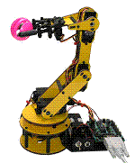
Environment Examples
Environment | Observable | Deterministic | Episodic | Static | Discrete | Agents
Chess with a clock | Fully | Strategic | Sequential | Semi | Discrete | Multi
Chess without a clock | Fully | Strategic | Sequential | Static | Discrete | Multi
Poker | Partial | Strategic | Sequential | Static | Discrete | Multi
Backgammon | Fully | Stochastic | Sequential | Static | Discrete | Multi
Taxi driving | Partial | Stochastic | Sequential | Dynamic | Continuous | Multi
Medical diagnosis | Partial | Stochastic | Episodic | Static | Continuous | Single
Image analysis | Fully | Deterministic | Episodic | Semi | Discrete | Single
Robot part picking
Fully observable vs. partially observable
Deterministic vs. stochastic / strategic
Episodic vs. sequential
Static vs. dynamic
Discrete vs. continuous
Single agent vs. multiagent

Slide 24
Environment Examples
Environment | Observable | Deterministic | Episodic | Static | Discrete | Agents
Chess with a clock | Fully | Strategic | Sequential | Semi | Discrete | Multi
Chess without a clock | Fully | Strategic | Sequential | Static | Discrete | Multi
Poker | Partial | Strategic | Sequential | Static | Discrete | Multi
Backgammon | Fully | Stochastic | Sequential | Static | Discrete | Multi
Taxi driving | Partial | Stochastic | Sequential | Dynamic | Continuous | Multi
Medical diagnosis | Partial | Stochastic | Episodic | Static | Continuous | Single
Image analysis | Fully | Deterministic | Episodic | Semi | Discrete | Single
Robot part picking | Fully | Deterministic | Episodic | Semi | Discrete | Single
Fully observable vs. partially observable
Deterministic vs. stochastic / strategic
Episodic vs. sequential
Static vs. dynamic
Discrete vs. continuous
Single agent vs. multiagent

Slide 25

Environment Examples
Environment | Observable | Deterministic | Episodic | Static | Discrete | Agents
Chess with a clock | Fully | Strategic | Sequential | Semi | Discrete | Multi
Chess without a clock | Fully | Strategic | Sequential | Static | Discrete | Multi
Poker | Partial | Strategic | Sequential | Static | Discrete | Multi
Backgammon | Fully | Stochastic | Sequential | Static | Discrete | Multi
Taxi driving | Partial | Stochastic | Sequential | Dynamic | Continuous | Multi
Medical diagnosis | Partial | Stochastic | Episodic | Static | Continuous | Single
Image analysis | Fully | Deterministic | Episodic | Semi | Discrete | Single
Robot part picking | Fully | Deterministic | Episodic | Semi | Discrete | Single
Interactive English tutor
Fully observable vs. partially observable
Deterministic vs. stochastic / strategic
Episodic vs. sequential
Static vs. dynamic
Discrete vs. continuous
Single agent vs. multiagent

Slide 26
Environment Examples
Environment | Observable | Deterministic | Episodic | Static | Discrete | Agents
Chess with a clock | Fully | Strategic | Sequential | Semi | Discrete | Multi
Chess without a clock | Fully | Strategic | Sequential | Static | Discrete | Multi
Poker | Partial | Strategic | Sequential | Static | Discrete | Multi
Backgammon | Fully | Stochastic | Sequential | Static | Discrete | Multi
Taxi driving | Partial | Stochastic | Sequential | Dynamic | Continuous | Multi
Medical diagnosis | Partial | Stochastic | Episodic | Static | Continuous | Single
Image analysis | Fully | Deterministic | Episodic | Semi | Discrete | Single
Robot part picking | Fully | Deterministic | Episodic | Semi | Discrete | Single
Interactive English tutor | Partial | Stochastic | Sequential | Dynamic | Discrete | Multi
Fully observable vs. partially observable
Deterministic vs. stochastic / strategic
Episodic vs. sequential
Static vs. dynamic
Discrete vs. continuous
Single agent vs. multiagent

Slide 27
THANK YOU

